Slide 1
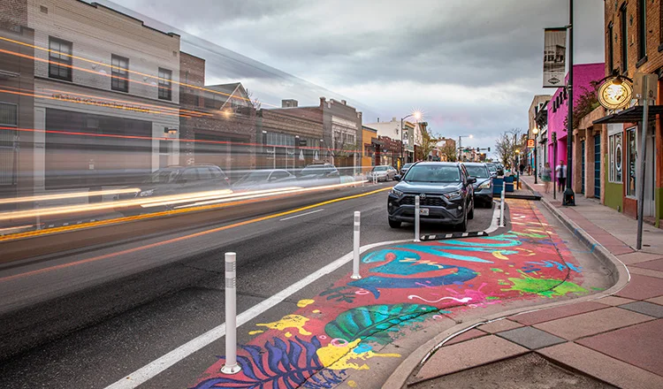
Integrating AI, Deep Learning, and Spatial Analytics to Investigate Environmental Correlates of Child Neglect
A Novel Integration of Social, Perceptual, and Built Environmental Data
Gia Elise Barboza-Salerno, MA, MS, JD, PhD
Colleges of Social Work and Public Health
The Ohio State University
Creator: Investigating Spatial Structures in Urban Environments (ISSUES) lab
barboza-salerno.1@osu.edu

Slide 2
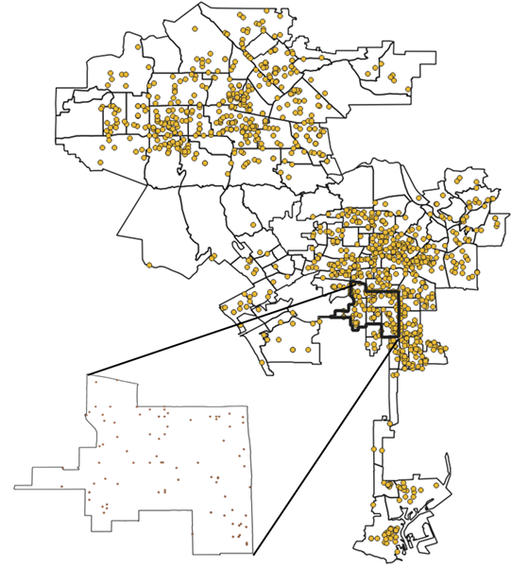
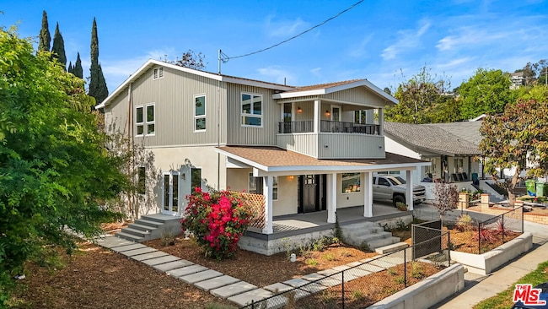
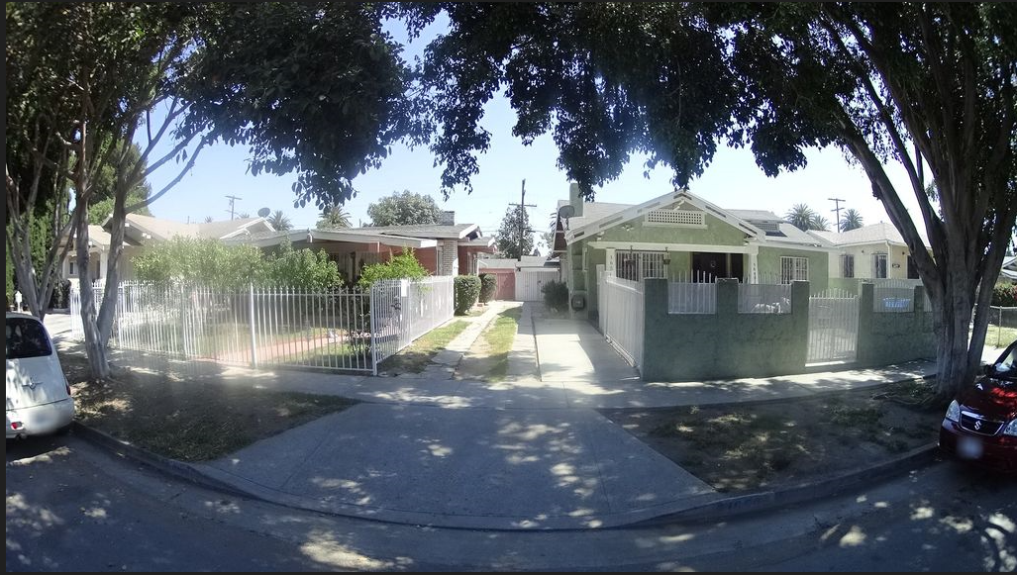
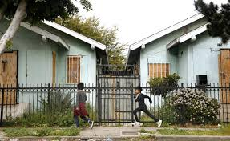
From Streets to Statutes: How Urban Environments Shape Neglect Risk
Child neglect is a public health and civil rights crisis
Legal Context
California WIC § 300(b)(1): Neglect is the failure of a parent or guardian to provide adequate food, clothing, shelter, or supervision, placing a child at risk of serious harm
Why ‘Place’ Matters
Neglect is not solely the result of individual or family circumstances
Risk is shaped by the neighborhoods where families live
Environmental conditions — housing quality, food accessibility, exposure to hazards — often align with the legal definitions of neglect
Advantages of AI algorithms
Connects objective measures (e.g., infrastructure, green space) with subjective impressions (e.g., safety, upkeep)
Produces a fuller picture of environments that may increase neglect risk
Extends and strengthens research on place-based prevention and intervention
Notes:
California’s Welfare and Institutions Code Section 300(b)(1) defines neglect as the failure of a parent or guardian to provide adequate food, clothing, shelter, or supervision, placing a child at risk of serious harm.
Those of us who study neighborhoods and child wellbeing understand that risk is shaped by the neighborhood we live in.
For example, if a family lives in a food desert, by definition, they do not have access to healthy, affordable food.
The local environment makes fulfilling the legal obligation very difficult.
Because the environmental burden of neglect is not equally distributed, child neglect is a civil rights and public health crisis.
Each point on the map shows the location of a police incident of child neglect in Los Angeles. To examine environmental burden we typically aggregate the incidents to neighborhoods and then use aggregate data on environmental factors from sources like census data.
These sources are valuable, but they don’t provide a sense of local neighborhood conditions.
Neighborhoods have both physical and perceived conditions. As you can see from the pictures here, these images carry both visible indicators and emotional cues about the environment where children grow up.
AI algorithms can analyze street-level imagery to detect objective physical features—like housing quality, green space, or infrastructure—and also can capture subjective impressions about how people feel about the neighborhood.
Pairing these locations with local environmental conditions (what we can see and how we feel about street-level imagery) can help us better understand—and ultimately address—the ecological drivers that increase neglect risk.
Presentation Script
California’s Welfare and Institutions Code Section 300(b)(1) defines neglect as the failure of a parent or guardian to provide adequate food, clothing, shelter, or supervision, placing a child at risk of serious harm.
But for those of us who study neighborhoods and child well-being, we know this risk isn’t just about individual families. It’s shaped by the neighborhoods where those families live.
Take food access as an example. If a family lives in a food desert, by definition, they don’t have access to healthy, affordable food. In that situation, meeting the legal requirement for adequate nutrition is not just a matter of parenting choices—it’s a matter of the environment itself. And because that environmental burden is not equally distributed—falling disproportionately on communities marked by systemic disinvestment—child neglect becomes both a public health and a civil rights crisis.
On the map, each point you see represents a police-reported incident of child neglect in Los Angeles.
Traditionally, researchers have looked at neighborhood correlates of neglect by summing the neglect cases and then using aggregate data—things like census measures or large-scale surveys. While useful, this approach doesn’t give us a sense of local neighborhood conditions at the street level.
Neighborhoods have both physical and perceived conditions. As you can see from the pictures here, these images carry both visible indicators and emotional cues about the environment where children grow up.
AI algorithms can analyze these images to detect both objective features and subjective impressions. Pairing neglect case locations with what parents experience and how they perceive it gives a clearer picture of ecological drivers and supports targeted prevention.

Slide 3
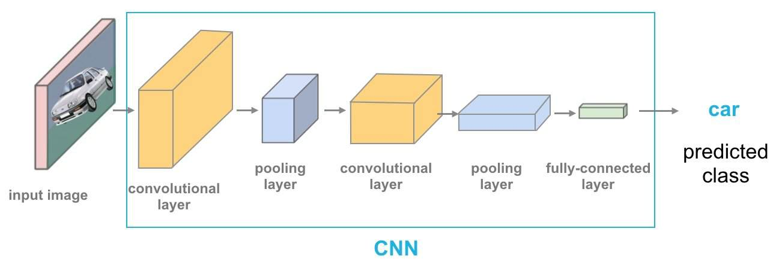
From Pixels to Neighborhood Patterns: How AI Translates Images into Indicators
AI uses computer vision models to teach computers how to view or interpret images using a deep learning method called semantic segmentation
The method scans every pixel in a street-level photo, interprets the image, and labels each feature, pixel-by-pixel
Applications of AI-driven computer vision with street-level images include:
Quantifying the built environment (e.g., green space, building structures, and open areas)
Evaluating neighborhood infrastructure (e.g., sidewalks, roads, lighting, and public spaces)
Capturing local perceptions: how do people perceive their environments (e.g., do they feel safe)?
Notes:
AI uses computer vision models to teach computers how to view and interpret images.
The system scans every pixel in a street-level photo, interprets what it sees, and labels each feature, pixel-by-pixel.
This diagram shows how AI ‘looks’ at an image. The image passes through several layers of a convolutional neural network, which combines visual clues in the street-level environment into meaningful patterns about neighborhood conditions.
The result is a prediction score or probability that can be used to quantify the built environment, evaluate local infrastructure, or capture local perceptions.
We use this same process on street-level photos, but instead of spotting just one object, our models label every pixel — identifying features like trees, sidewalks, buildings, and roads."

Slide 4
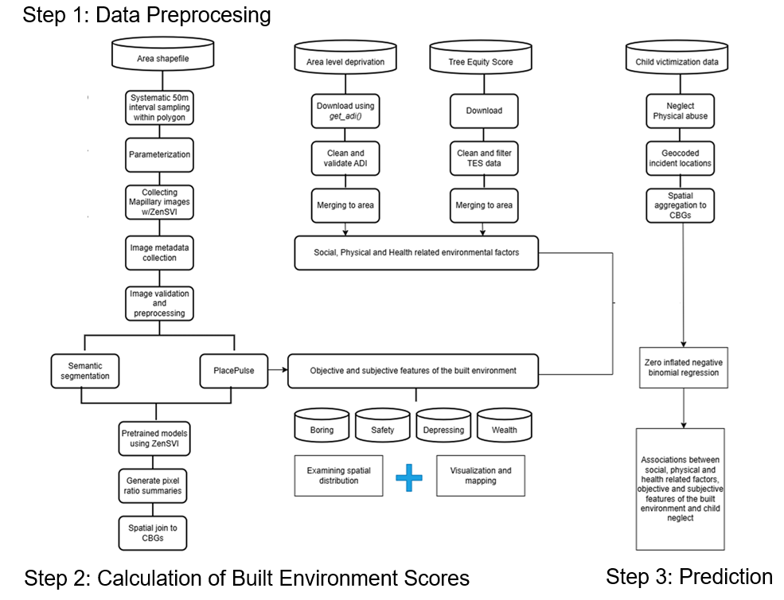
Connecting the Built Environment and Perceptions of Place to Neglect Risk
Notes:
*"Here’s the big picture of how we bring all the pieces together.
We start with a map of our study area and systematically collect thousands of street-level images using ZenSVI and Mapillary.
ZenSVI is a Python toolkit that automates downloading, processing, and analyzing street-level images for environmental research.
Mapillary is an open, crowd-sourced platform of street-level imagery, contributed by people all over the world, that provides a massive, up-to-date photo database of roads, sidewalks, and neighborhoods.
Alongside these images, we bring in neighborhood data like the Area Deprivation Index, the Tree Equity Score, and geocoded child neglect reports.
Next, we run the images through two AI models. One uses semantic segmentation to identify objective features — like vegetation, sidewalks, and buildings. The other, based on PlacePulse, scores subjective impressions — such as whether a place feels safe, depressing, or boring.
We combine these objective and subjective measures into a set of social, physical, and health-related environmental factors.
Finally, we analyze the relationship between those factors and neglect reports using a spatial statistical model, to see how the built environment and perceptions of place align with legal definitions of neglect

Slide 5
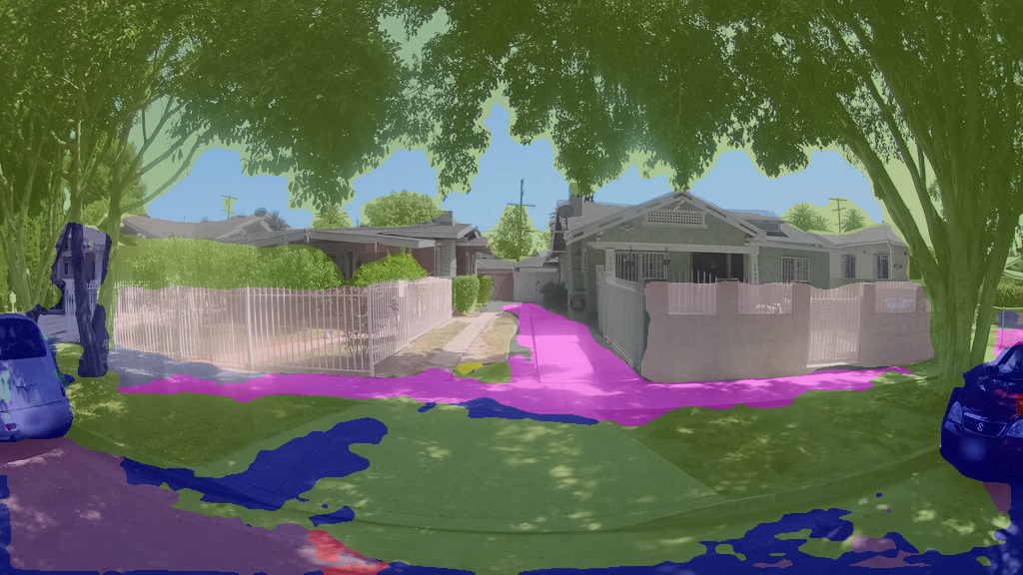
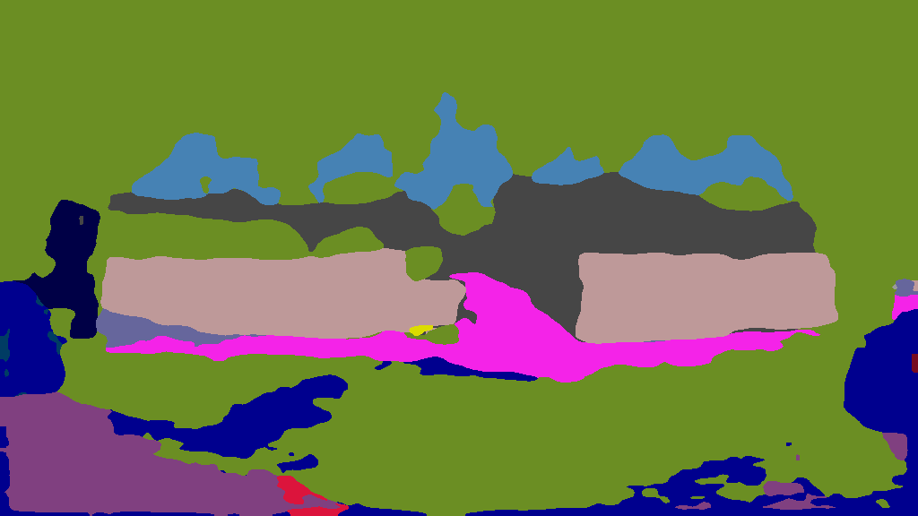
AI-Driven Semantic Segmentation
Original Image
Street-level image showing:
Homes
Vegetation
Vehicles
Sidewalks
Roads
Segmentation Overlay AI highlights each feature:
Light Brown/Grey: Building façades
Green: Vegetation
Blue: Vehicles
Pink/Purple: Sidewalks
Dark Blue: Roads
Segmentation Mask
AI segmentation detects the most common categories in each image:
59.1% vegetation
9.64% fences
7.76% buildings
4.94% roads
4.31% sidewalks
Notes:
*"Here’s what it looks like when AI ‘reads’ a street-level image. At the top, you see the original photo.
The middle image shows an overlay — each pixel is classified into a category, like vegetation in green, sidewalks in pink, or buildings in grey.
The bottom image is the segmentation mask, where every pixel is replaced by a solid color representing one feature. From this, we can calculate exactly how much greenery, road, or built structure is visible.
This turns everyday street images into precise, measurable data about the built environment."*
"For this one image, vegetation covers almost 60% of what you see, buildings about 8%, and fences around 10%. We can get this level of detail for every image — and then aggregate it across entire neighborhoods."

Slide 6
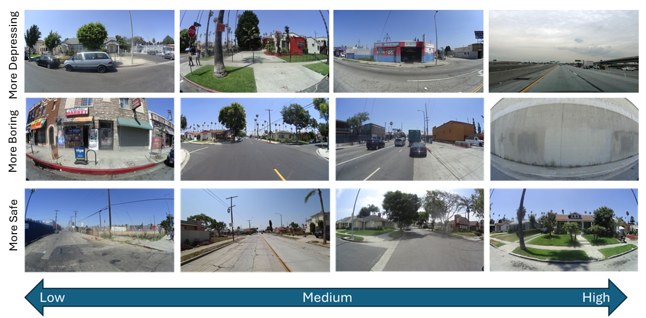
Add Perception Scores
Classified images using deep learning models trained to recognize subjective neighborhood impressions
0
10
Notes:
*"So far, we’ve looked at what’s physically present in a neighborhood. But places also have a feel — and that matters for how families experience them.
Here, AI models trained on thousands of human ratings score images for qualities like how safe, boring, or depressing they appear.
On this chart, you can see examples ranging from low to high. These perception scores let us combine the objective and the subjective — turning street views into data about both the environment and the experience of living there."*

Slide 7
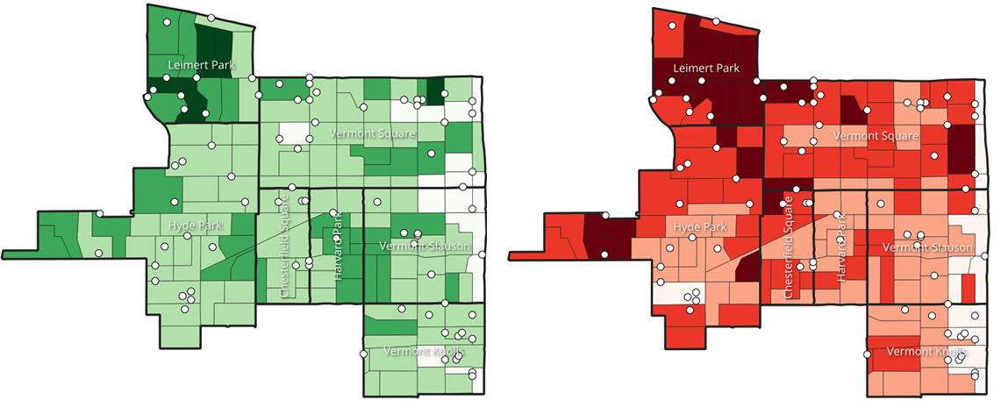
The Spatial Distribution of the Built and Perceived Environment
Neighborhood Vegetation
(Objective Score Summary)
Neighborhood Safety
(Perception Score Summary)
Notes:
*"On the left, darker green areas have more vegetation. On the right, darker red areas are perceived as safer.
When you look at them side by side, you can see a pattern — neighborhoods with more greenery often have higher safety perceptions.

Slide 8
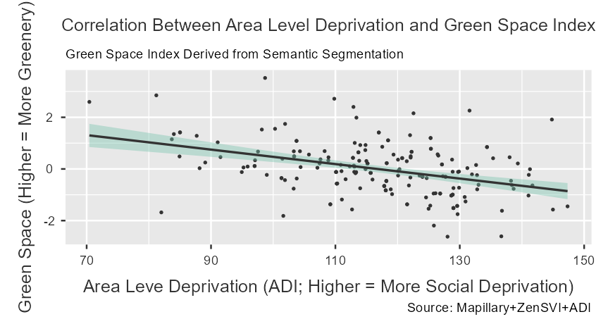
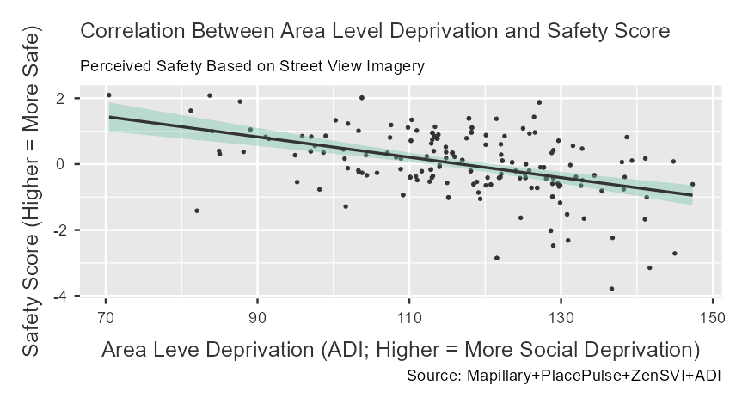
Higher Social Deprivation = Lower Green Space and Safety Perceptions
Figure 1. Correlation between Area Level Deprivation and Green Space Index. This scatterplot shows a negative association between the Area Deprivation Index (ADI; higher values indicate more social deprivation) and the Green Space Index derived from AI-based semantic segmentation.
Figure 2. Correlation between Area Level Deprivation and Safety Perception Score. This scatterplot depicts the relationship between the ADI and perceived safety scores derived from AI-based perception models.
Neighborhoods facing greater social disadvantage tend to have both fewer environmental assets and lower safety perceptions — two factors that can compound neglect risk
Notes:
*"These plots show how the built and perceived environments relate to social deprivation, measured by the Area Deprivation Index, or ADI.
On the left, higher deprivation scores are associated with less visible green space. On the right, higher deprivation is also linked to lower perceived safety.
In other words, neighborhoods facing greater social disadvantage tend to have both fewer environmental assets and lower safety perceptions — two factors that can compound neglect risk."*

Slide 9
Descriptive Links Between Environment, Perception, Social Deprivation, and Child Neglect Risk
Note: Higher score = greater values of the indicator
Variable | Definition / Measures | Δ | Effect Size
Green Space Index | Mean neighborhood score of vegetation cover, visible sky, and terrain, etc. | 0.436 | 0.442
Surveillance Index | Mean neighborhood score of building frontage, fences, and walls, etc. | -0.121 | -0.146
Land Use Mix Index | Mean neighborhood score of bicycles, buses, cars, motorcycles, pedestrians, riders, roads, sidewalks, trains, and trucks, etc. | 0.200 | 0.269
Lighting Index | Mean neighborhood score of streetlights, traffic lights, poles, etc. | 0.129 | 0.336
Safety Perception | Mean neighborhood perceived score for ‘safer’ | 0.249 | 0.255
Boring Score | Mean neighborhood perceived score for “boring” | 0.0439 | 0.0446
Area Level Deprivation (ADI) | Area Deprivation Index | -9.478 | -0.712
High-neglect areas tend to have less greenery, poorer built environment conditions, lower perceptions of safety, and much higher levels of social deprivation.
Notes:
*"This table shows the average differences in our environmental and perception measures between CBGs with high child neglect rates and those with low rates.
"High-neglect areas tend to have less greenery, poorer built environment conditions, lower perceptions of safety, and much higher deprivation. Other factors like surveillance or boredom didn’t differ much. This reinforces that environmental quality and perceived safety are closely tied to neglect risk."

Slide 10
Policy Implications and Future Directions
Implications for child welfare systems
Isolate factors associated with high risk: Identifies objective (e.g., green space, infrastructure) and subjective (e.g., safety perception) measures strongly associated with neglect risk
Target high-risk locations: Spatial analysis detects where the association between environmental exposure and neglect risk is highest
Evaluate for policy relevance: Do California’s legal mandates for neglect align with measurable neighborhood conditions?
Other ISSUES lab applications using machine learning
Structural Topic Models: Analyze narrative or text data (e.g., fatality reports, death records, police incidents) to detect spatial and thematic patterns
Spatial Random Forest: Predict and map violence-related harms using environmental, social, and spatial features to detect the most important variables
Application of predictive analytics: Evaluate the conditions in which child welfare systems can use predictive analytics to prevent child harm (versus those that cause further harm)

Slide 11
File Name | Measure | Unit of Analysis
pixel_ratios_wide.csv | Pixel-level proportion of each semantic segmentation class in a single image. pivoted to wide format — one row per image with each label as its own column. | Image-level
pixel_ratios_with_coords.csv | Pixel ratio data joined with lat/lon from mly_pids_renamed.csv. | Image-level with coordinates
mly_pids_renamed.csv | Mapillary photo IDs and coordinates for downloaded images with consistent column names for merging with segmentation output. | Image-level
combined_summaries_<indicator>_results.csv | Combined perception classification scores (e.g., “more depressing”) for all batches. | Image-level
summaries_<indicator>_map.geojson | Geospatial file mapping perception scores to coordinates. | Image-level with coordinates
image_metadata.csv | Image-level metadata from Mapillary (speed, heading, capture time, sequence). | Image-level
street_metadata.csv | Aggregated metadata per Mapillary sequence (street segment). | Street-segment level
grid_metadata.csv | Aggregated metadata by H3 hexagon grid. | Grid level
The code used to run this analysis is available on my lab’s GitHub website (in progress):
issues-osu/ai-neglect

